Slide 1
Bench Mark (B.M)
It is a fixed reference point whose elevation with respect to some datum is known. It is noted that any leveling work is first started from BM.

Slide 2
Types of Bench Mark
GTS (Great Trigonometric Surveying)
Permanent
Temporary
Arbitrary

Slide 3
GTS
GTS are establish in Pakistan by fedral government department. Survey conduct in all over the country at large interval may be 100-150 km. These bench marks are highly precise.

Slide 4
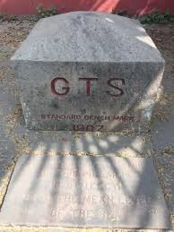
GTS benchmark

Slide 5
2. Permanent
This type of bench mark is establish by Irrigation department, Communication & Work department, highway department and Railway department. These are also establish with the help of GTS.

Slide 6
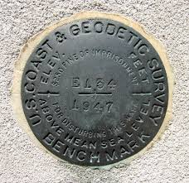
Permanent benchmark

Slide 7
3. Temporary
These are establish temporary after on day working. So, next day work can start from there.

Slide 8
4. Arbitrary
In many engineering projects the difference in elevations of neighboring points is more important than their reduced level with respect to mean sea level. In such cases a relatively permanent point, like plinth of a building or corner of a culvert, are taken as benchmarks, their level assumed arbitrarily such as 100.0 m, 300.0 m, etc.

